Slide 1
Lecture 13:
Environmental Legislation in India - II
Course: Environment and Politics in India

Slide 2
Major Issues
  Debates around law-making:
  State governments versus Union/Centre (EXAMPLES: PESA)
UNITARY
FEDERAL
All powers concentrated in single government
  Centralised
  Decentralised
  Regionalised
Power distributed between multiple levels of government
  Centralized
  Decentralized
Based on principle of shared rule plus self rule
  Linked to democracy, sharing, diversity and the maintenance of distinctive identities
Separation of powers-constitution

Slide 3
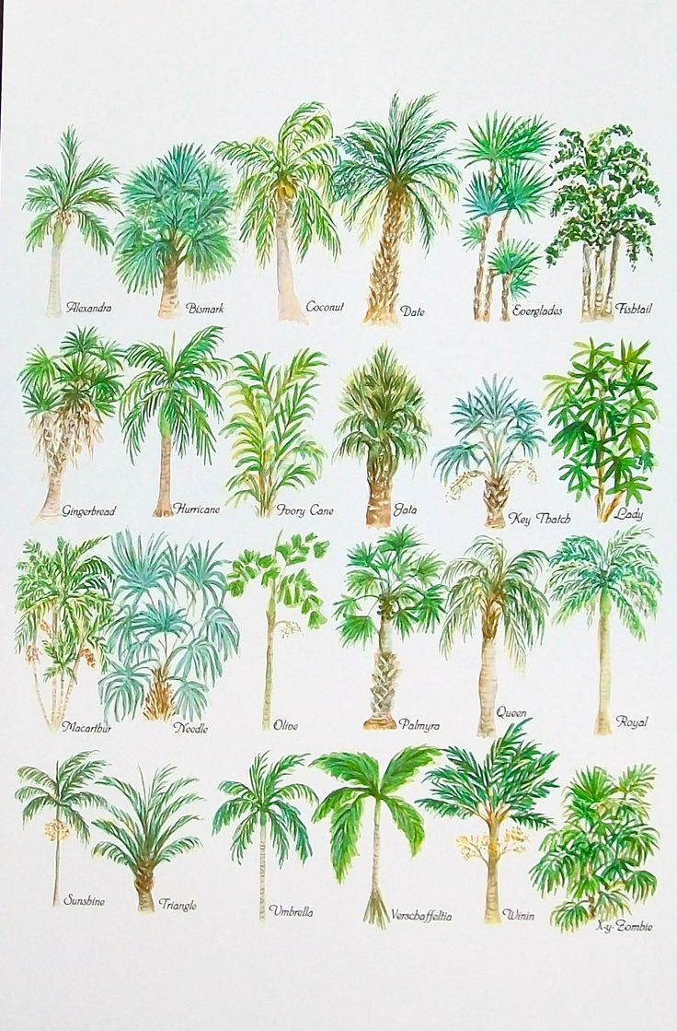
Varieties of Federations
Federal idea can take DIFFERENT forms.
No ONE model of federalism.
Depends on:
  Historical circumstances
  Emergent demands and needs of societies
  Nature of population, diversity and so on

Slide 4
Models of Federalism
Coming Together Model
  where (more or less) sovereign states come together to create a common central government to which the states surrender some of their sovereignty
    United States
Holding Together Model
  A larger polity is subdivided into various sub-units that enjoy sovereignty over certain policy areas
    Belgium, India
Putting Together Model
  A large unit forcefully brings together previously independent units and takes away some of their sovereignty and allows some sovereignty in certain areas
  Former USSR, Yugoslavia

Slide 5
Historical Background
Indian model
Fear of disunity
Strong-centre model of federation
Powerful central government to lead from the front: economic, political, social
Protect India’s freedom
Federalism to suit India’s needs and requirements
Partition and communal riots that followed
Migration and influx of millions of people
Invasion of Jammu and Kashmir
Problem of princely states
Danger of extremist violent groups

Slide 6
Other factors
Unification of Princely states
Goals of National Unity and Integrity, Democracy and Social and Economic development
Balanced regional development
Congress everywhere: One-party dominant
  Reinforced the centralizing component
Global circumstances

Slide 7
Major Issues
  Debates around law-making:
  Executive versus Judiciary (Markandey Katju and Air Pollution in Delhi)
  Other issues:
  Balancing various POLITICAL/ECONOMIC/SOCIAL interests
  EXAMPLES: Tiger conservation versus shikar/tourist lobby

Slide 8
Water Pollution Act
  Passed in 1974
  Took FIVE years to pass after the initial draft
    Was FIRST introduced in Parliament in December 1969
    Got a major boost after the Stockholm 1972 conference
    Opposition? Question of Federalism.
    ELEMENTS of the ideological/power struggles
      Part XI of the Constitution allows DISTRIBUTION of legislative/administrative/executive powers between Centre/Union/Federal government and state governments.
      Water: 17 in the STATE list, 56 in the UNION list. States responsible to handle water pollution.
      Active opposition from Maharashtra.
      SOLUTION? Formation of the CPCB/SPCBs. INSTITUTIONAL distribution of powers.

Slide 9
Air Pollution Act
  Passed in 1981
  Took EIGHT years to pass after the initial draft
  Possible Issues?
    Debate over Federalism
    Debate over the extent of air pollution. ‘Development’ versus Environment?
    Debate over WHO should pay, WHY they should pay and HOW much.
    EXAMPLE: Small versus Large industries

Slide 10
Wildlife Protection Act
  Passed in 1972, after much back-and-forth arguments
  Problems of Federalism
  “Our Fauna is already dangerously depleted. It is an asset to be cherished and conserved. In recent years, I have had to intervene more than once with the States in this matter. It is essential for the Centre to give a lead…” – Indira Gandhi
  Local communities versus Wildlife Conservation.
  Industrial Forestry versus Wildlife Conservation.
  Contractors Lobby versus Wildlife Conservation.
  Dams versus Wildlife Conservation. EXAMPLE: Silent Valley project.
  ‘Scientific study’ of wildlife versus Wildlife Conservation.
  EACH declaration of a ‘NATIONAL’ Park saw much lobbying/counter-lobbying between ACTIVISTS, STATES and the CENTRE.
  EXAMPLE: Dudhwa National Park and Billy Arjan Singh
  Crucial ROLE of powerful individuals and social networks.

Slide 11
Forest Conservation Act
  1976: Forests AND Protection of Wild Animals and Birds were moved from the STATE to the CONCURRENT list. WHY?
  March 1980: Meeting with Conservationists. Concern over dwindling forest cover, NO discussion on any Bill/Act.
  June 1980: Draft law drafted by Samar Singh.
  October 1980: Article 123(1), Ordinance passed.
  December 1980: Bill passed.

Slide 12
Forest Conservation Act
  Notwithstanding anything contained in any other law for the time being in force in a State, no State Government or any other authority shall make, except with the prior approval of the Central Government, any order directing –
  That any reserved forest (within the meaning of the expression “reserved forest” in any law for the time being in force in that State) or any portion, thereof, shall cease to be reserved;
  That any forest land or any portion thereof may be used for non-forest purposes.
  Explanation: For the purpose of this section “non-forest purpose” means breaking up or clearing of any forest land or portion thereof for any purpose other than reafforestation.
  - Abstract from Draft FCA Bill

Slide 13
Forest Rights Act (FRA)
  Scheduled Tribes and Other Traditional Forest Dwellers (Recognition of Forest Rights) Act, 2006

Slide 14
Adivasis, Forest dwellers and the Forest
“ The forest is like our Mother. We know how to live by suckling at its breast. We know the name of every tree, shrub and herb. We know its uses. If we were made to live in a land without forests. Then all this learning that we have cherished, over the generations will become useless. And slowly, we will forget it all.” 
- A Bhil Tribal protesting against the forced evictions for Narmada Project

Slide 15
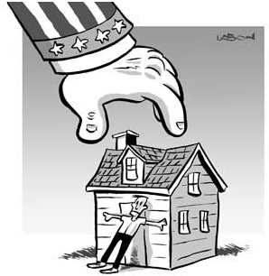
Eminent Domain Principle
The State’s right to seize a citizen's private property with due monetary compensation, but without the owner's consent. State as guardian of ‘national’ interests (aka ‘commercial’ interests).
Colonial rule and the Eminent Domain principle: Implemented in the Indian Forest Act 1927. Restriction of public access to forests (and fuel/fodder/food).
Principle continues in INDEPENDENT India

Slide 16
Eminent Domain Principle
Phases of forest use in independent India:
Phase 1 (1947–1970): Commercial exploitation of forests for industrial development
Phase 2 (1970–1988): Conservation with increased Government control. Forest conservation was made a directive principle, a fundamental duty in the Constitution.
Forests in Concurrent list, Passing of the FCA, Wildlife Protection Act.
No space for forest dwellers and tribals.
Phase 3 (1988 onwards): Introduction of the National Forest Policy in 1988. Forest as a local resource MANDATORILY REQUIRING participation of local forest protecting communities.

Slide 17
Eminent Domain Principle
BREAKING of the Eminent Domain Principle
Panchayat Extension to Scheduled Area Act, 1996 (PESA): Additional powers to local gram sabhas. Gram sabhas to manage, control, arbitrate over adivasi-dominated forest areas “according to the customs and traditions of the people” .
FRA: Next stage of breaking the eminent domain principle.
FEATURES of the FRA
Gives rights to adivasis and other ‘forest dwellers’ in the form of “responsibilities and authority for sustainable use, conservation of biodiversity and maintenance of ecological balance”. Adivasis as ecological conservationists.
Right to land under individual or communal occupation for habitation
Right to Grazing, including right to protect and regenerate
Right of ownership, access to collect non-timber forest produce
Right of access to biodiversity and traditional Knowledge

Slide 18
FRA
FEATURES of the FRA
Maximum of 4 hectares of land to individual Scheduled Tribes and other forest dwellers, ON PROOF of long-term occupation in the forest area.
Recognition of rights over “community forest resource”.
Crucial aspects of the Forest Rights Act is the realization of forest rights EVEN within a protected area through declaration and demarcation of the “critical wildlife habitat”
ISSUES:
WHO is a ‘forest dweller’?
What is “Bonafide Livelihood Needs”? Not defined.
Definition of NTFP (Wildlife? Fuel? Resin?)
Provides RIGHTS, but not the “POWERS” to protect forests/wildlife.
Limited powers of Gram Sabhas. Can only INITIATE rights and escalate recommendations to the next tier of governance.

Slide 19
Conflict areas
Vanashakti advertisements/’A Weapon of Democracy’ (CSD)
‘Wildlife’ lobby versus Tribal lobby. Tigers versus adivasis? Questions of:
  WHO poaches and WHY?
  PROVING that community presence damages wildlife
  WHY and HOW should resettlement happen?
  Recognition of people’s rights over land for resettlement
  Allowing community participation/agreement to resettlement packages
  Providing full facilities are provided at the resettlement site

Slide 20
Conflict areas
Industry lobby versus Tribal lobby. ‘Environment’ lobby often working WITH industry lobby.
FACTS:
  90% of India’s grasslands have been converted to COMMERCIAL Forest Department plantations
  Five lakh hectares of forest converted in five years alone (2001-2006) for mines, dams and industrial projects
  Conversion of millions of hectares of forest for monoculture plantations by the Forest Department
  Proposals to privatise “degraded” forest lands for private companies’ timber plantations

Slide 21
Conflict areas
‘Forest’ lobby versus adivasi lobby. Arguments:
  4 hectares of land to each adivasi family will destroy forests
  ‘Forests’ are arbitrarily designed, Adivasis need rights over forest produce
  FRA will open gates to land grabbing
  WHO should protect forests? Government or forest dwellers? Or BOTH?

Slide 22
MoEF versus MOTA
  November 2012 PMO meeting with MoEF and MoTA: Efforts to dilute powers of the gram sabhas to ONLY consultation.
  MoTA’s concern with the non-implementation of the FRA.
  MoTA’s demands that FRA is not only about “recognising rights”, but equally about adivasis’ right to manage forests THEMSELVES.

